Slide 1
CAPSTONE PROJECT
CORONARY HEART DISEASE - CARDIOVASCULAR RISK PREDICTION
Presented By:
ASHWIN R
2021308008
College name: Alagappa College of Technology , Anna University
Department: B.Tech PHARMACEUTICAL TECHNOLOGY

Slide 2
OUTLINE
Problem Statement
Proposed System/Solution
System Development Approach
Algorithm & Deployment
Result
Conclusion
Future Scope
References

Slide 3
PROBLEM STATEMENT
This project aims to understand how coronary heart disease affects the
normal life of human beings.

Slide 4
PROPOSED SOLUTION
Utilizing advanced machine learning algorithms, our solution will analyze extensive students performance in exams to establish patterns and correlations.
Solution could be to conduct a comprehensive statistical analysis using techniques such as regression analysis or machine learning algorithms.
This would involve examining the correlation between student performance and each of the mentioned factors (gender, race, parental level of education, lunch, test preparation course) while controlling for other variables.
Additionally, visualizations like matplotblob, seaborn can help to illustrate patterns and relationships in the data.

Slide 5
SYSTEM APPROACH
Building the proposed solution would involve a combination of data processing, feature engineering, and machine learning. Here are the key system and library requirements:
System Requirements:
Hardware:- A computer with sufficient processing power, preferably with multiple cores or a GPU for faster training of machine learning models.- Adequate RAM to handle the size of the dataset and computational requirements.
Software: An operating system compatible with the required machine learning libraries (e.g., Windows, Linux, macOS).

Slide 6
SYSTEM APPROACH
Library Requirements:
Data Processing and Analysis:-
Pandas: For data manipulation and analysis.-
NumPy: For numerical operations on data.
Data Visualization:-
Matplotlib and Seaborn : For creating visualizations to understand data patterns.

Slide 7
ALGORITHM & DEPLOYMENT
Designing an algorithm for analyzing student performance typically involves several steps:
1. *Data Collection*: Gather data on students' performance in exams, including scores, demographic information (gender, ethnicity), parental level of education, lunch status, and whether they took a test preparation course.
2. *Data Cleaning and Preprocessing*: Clean the data by removing any errors or inconsistencies, and preprocess it by handling missing values and encoding categorical variables.
3. *Feature Engineering*: Create new features or transform existing ones to better represent the relationships between the variables. For example, you might create a feature indicating whether a student received free lunch or not based on their lunch status.

Slide 8
ALGORITHM & DEPLOYMENT
4. *Model Selection*: Choose appropriate machine learning models for predicting student performance based on the features available. This could include regression models, classification models, or more complex models like random forests or neural networks.
5. *Model Training*: Train the chosen model on a portion of the data, using techniques like cross-validation to ensure generalization to unseen data.
6. *Model Evaluation*: Evaluate the performance of the trained model using appropriate metrics, such as accuracy, precision, recall, or mean squared error, depending on the nature of the problem (classification or regression).

Slide 9
ALGORITHM & DEPLOYMENT
7. *Deployment*: Deploy the trained model in a suitable environment, such as a web application or API, where it can be used to make predictions on new data.
When deploying the model, it's important to consider factors like scalability, latency, and security. Additionally, regular monitoring and updates may be necessary to ensure the model continues to perform well as new data becomes available or as the underlying factors influencing student performance change over time.

Slide 10
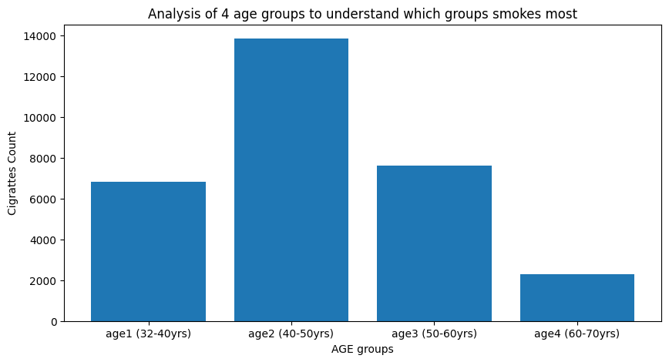

Slide 11
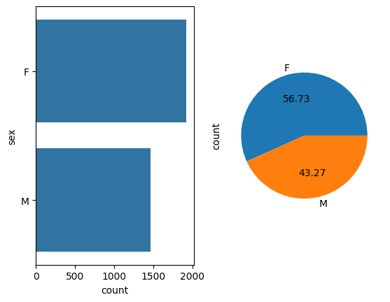
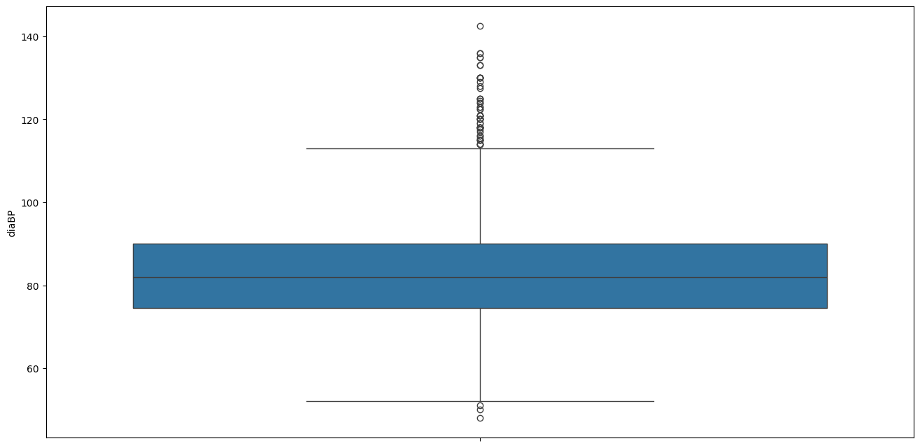
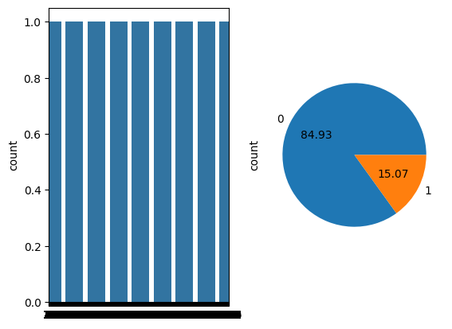
RESULT

Slide 12
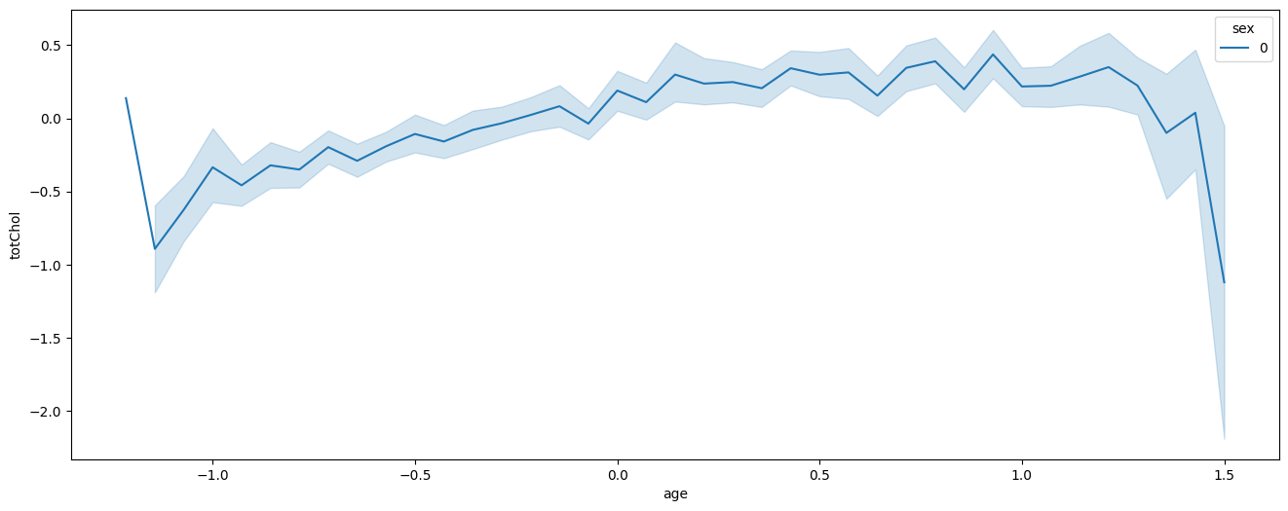

Slide 13
CONCLUSION
In Conclusion,both males and females from age 42 to 55 people don't have any CHD Problem but from age around 50-60 people do have CHD problems.And Till age 53 BMI is increasing in both male and females but after 53 male's BMI is decreasing slightly and in Women's BMI is still rising.On average, the patients with higher pulse pressure are exposed to the coronary heart disease over the period of 10 years.Only ~15% of the patients in the study were eventually exposed to the risk of this heart disease, rest of the patients were not exposed to this disease after the end of 10 year study.

Slide 14
FUTURE SCOPE
By leveraging historical data and machine learning algorithms, educational institutions can develop models to predict the likelihood of academic success for individual students based on their demographic and socioeconomic characteristics.
This proactive approach can help identify at-risk students early on and implement targeted interventions to improve their academic performance and overall educational experience.
Additionally, further research could explore the intersectionality of these factors to gain a deeper understanding of how multiple variables interact to influence student outcomes.

Slide 15
REFERENCES
https://www.kaggle.com/datasets
https://pandas.pvdata.org/pandas-docs/stable/user guide/index.html
https://seaborn.pydata.org/
https://matplotlib.org/stable/contents.html

Slide 16
THANK YOU

